Slide 1
Unit-3
Food safety standards: Food Hygiene
Food safety is the prevention of food contamination prior to its being released to the consumer
Importances of food safety and hygiene
Prevent food spoilage,
Protect food from adulteration (intentional contamination). Provide Clean, Safe, Healthful Food to Consumer
Provide Clean, Safe, Healthful Food to Consumer
Food Permits Growth
Control of Microbial Growth
Prevent Food Spoilage
Prevent Food-borne Illnesses
Food Preservation and Production

Slide 2
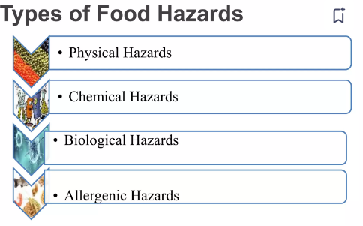
Food hazards
Food hazards refer to any biological, chemical, or physical agent in food that may cause harm to the consumer.

Slide 3
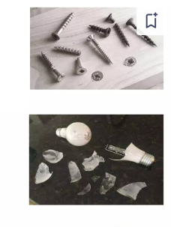
Physical Hazard means the foreign objects that comes to food from raw, preparation and final stages of food manufacturing can cause illness to the humans.
Example : stones,wood and plastics, metallic pieces, glass pieces etc

Slide 4
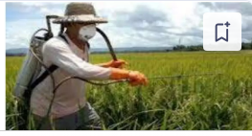
Chemical Hazards - A chemical hazard is any chemical contaminant introduced in food system which may cause illness or injury to the individuals using the product.
Chemical contaminants: Pesticides, herbicides, and heavymetals, Food additives such as artificial colors, preservatives, and flavor enhancers.
.

Slide 5
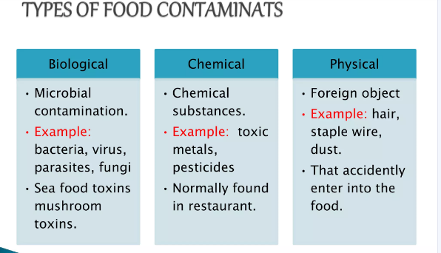
Biological Hazard
Biological hazards include bacterial, fungal, viral and parasitic organisms (protoz oa and worms) and/or their toxins. There are many microorganisms, which are pathogenic to humans, but relatively few are associated with foods. These microorganisms that cause diseases are termed as food-borne pathogens’.

Slide 6
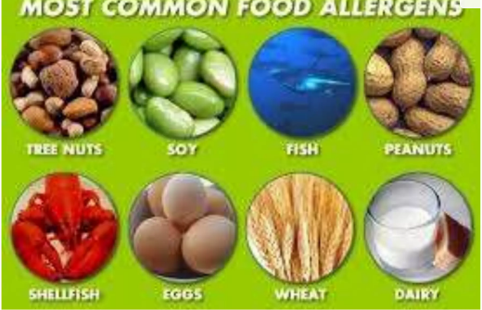
Allergenic Hazards:
Certain foods and food ingredients can cause allergic reactions in susceptible individuals.

Slide 7
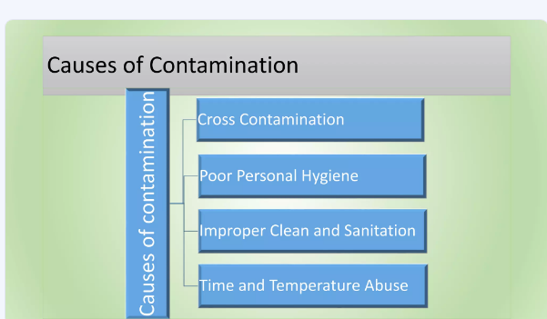
Food borne illness, - food poisoning
Eating contaminated, spoiled, or toxic food such as poisonous mushrooms also..
Most common symptoms of food poisoning include nausea, vomiting and diarrhea.
According to the centers for disease control and prevention (CDC) 1 in 6 people will contract some form of food poisoning in every year.
Factors that contribute to foodborne illness

Slide 8
Factors that contribute to foodborne illness
Microbial Contamination:
Cross-Contamination:
Improper Food Handling and Storage:
Contaminated Water and Ice:
Inadequate Cooking or Heat Treatment:
Contaminated Equipment and Utensils:

Slide 9
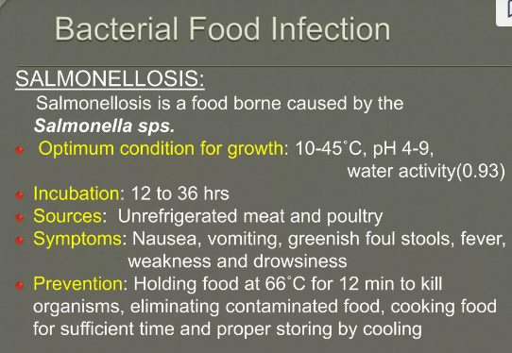

Slide 10
Preventing Foodborne Illness
well cooked food were eaten.
Always wash your hand before and after cooking.
Avoid contaminated water to drink.
The fruits and vegetable were washed before use.

Slide 11
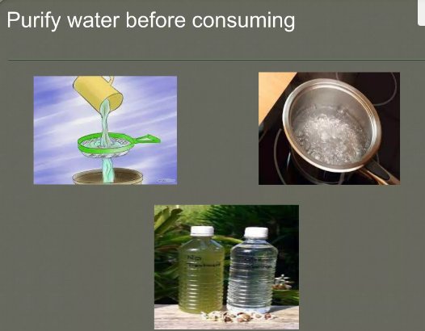
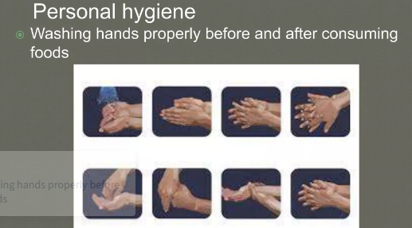

Slide 12
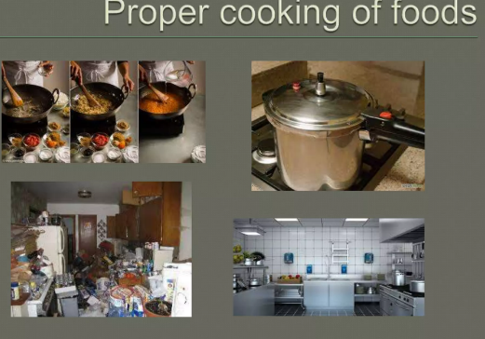

Slide 13
Food Microbiology
Food microbiology is a branch of microbiology that deals with microorganisms present in food, their interactions, and their impact on food quality, safety, and shelf life.

Slide 14
General principles of food microbiology
1.Microbial Growth: Microorganisms require specific conditions to grow and reproduce, including nutrients, pH, temperature, and water activity (aw). Understanding these factors helps in controlling microbial growth in food.
2.Types of Microorganisms: Common types of microorganisms in food include bacteria, yeasts, molds, and viruses. Each has different growth requirements and impacts food differently.
3. Spoilage: Microorganisms can cause food spoilage through various mechanisms, including production of enzymes, acids, and toxins, leading to changes in taste, texture, and appearance.

Slide 15
General principles of food microbiology
1.Microbial Growth: Microorganisms require specific conditions to grow and reproduce, including nutrients, pH, temperature, and water activity (aw). Understanding these factors helps in controlling microbial growth in food.
2.Types of Microorganisms: Common types of microorganisms in food include bacteria, yeasts, molds, and viruses. Each has different growth requirements and impacts food differently.
3. Spoilage: Microorganisms can cause food spoilage through various mechanisms, including production of enzymes, acids, and toxins, leading to changes in taste, texture, and appearance.

Slide 16
General principles of food microbiology
4. Food Safety: Some microorganisms can cause foodborne illnesses (food poisoning) by producing toxins or by infecting the consumer. Pathogenic bacteria like Salmonella, Listeria, and E. coli are significant concerns.
5. Food Preservation: Techniques such as heat processing (e.g., pasteurization, sterilization), refrigeration, freezing, drying, fermentation, and use of preservatives are used to control microbial growth and extend shelf life.
6. HACCP (Hazard Analysis Critical Control Points): A systematic preventive approach to food safety that identifies, evaluates, and controls hazards throughout the food production process.

Slide 17
General principles of food microbiology
7. Quality Control: Microbiological testing and monitoring are essential for ensuring food safety and quality. This includes testing for pathogens, spoilage organisms, and indicators of hygiene and cleanliness.
8. Regulatory Standards: Food microbiology is guided by national and international regulations and standards that specify acceptable levels of microorganisms, hygiene practices, and safety measures in food production and handling.
9. Emerging Issues: Changes in food production practices, global food trade, and consumer preferences continuously influence food microbiology. Issues such as antimicrobial resistance and novel food technologies are also areas of concern.
10. Education and Research: Ongoing research in food microbiology focuses on understanding microbial behavior, developing new preservation techniques, and improving food safety measures.

Slide 18
Why these principles?
Understanding these principles helps food scientists, producers, and regulators ensure that food is :
safe,
nutritious,
and of high quality
throughout its production,
distribution,
and consumption.

Slide 19
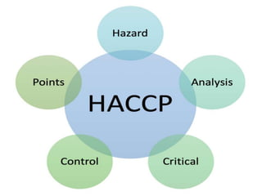
Food Safety Regulations
A basic food safety plan uses the HACCP method.

Slide 20
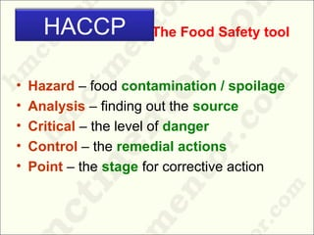

Slide 21
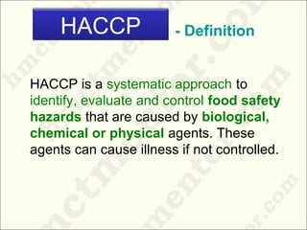

Slide 22
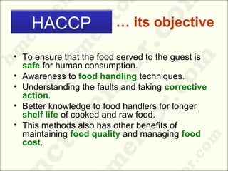

Slide 23


Slide 24
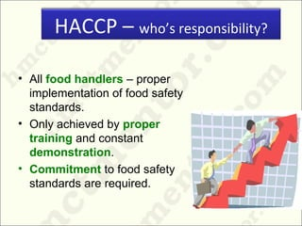

Slide 25
7 Principles of HACCP
Principle 1: Conduct a Hazard analysis
List all the steps in the food process and identify the possible hazards.
Example–Cooking step
Danger: Harmful bacteria may survive if food is not cooked properly.
Principle 2: Identifying critical control points
A CCP is the step where a hazard must be checked and controlled.
Example – Cooking step
Cooking is a CCP because correct heating kills dangerous bacteria.

Slide 26
Principle 3: Establishing critical limits for each critical control point
Decide the minimum or maximum values (time, temperature, pH, etc.) required to keep food safe.
Principle 4: Establishing monitoring procedures for critical control points
measure the critical limit.
Check if the internal temperature using a food thermometer

Slide 27
Principle 5: Establishing corrective actions
Decide what to do when the limit is not reached.
Example: If the food temperature is only 55°C:
Continue cooking until it reaches ≥65°C
Check why the temperature dropped (equipment issue, wrong settings, etc.)
Fix the cause so it does not happen again
Principle 6: Establishing verification procedure
To ensures everything is working correctly
Example: Check thermometer accuracy
Measure temperature, It should read correct required temperature, if not, adjust it, Review cooking log sheets, Audit CCP steps

Slide 28
Principle 7: Record Keeping
Keep written proof of all HACCP activities.
Example – Cooking temperature records
Cooking log sheet with:
  Date
  Batch time
  Temperature reading
  Employee signature
Deviation log (if temperature was too low)
Calibration record for thermometer
These records show auditors that food was cooked safely.

Slide 29
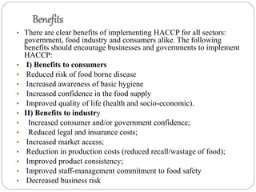

Slide 30
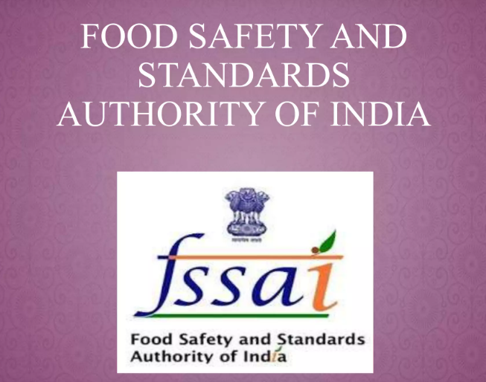

Slide 31
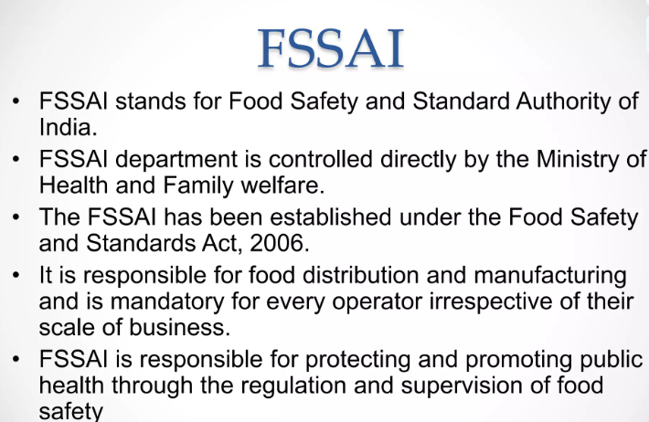

Slide 32
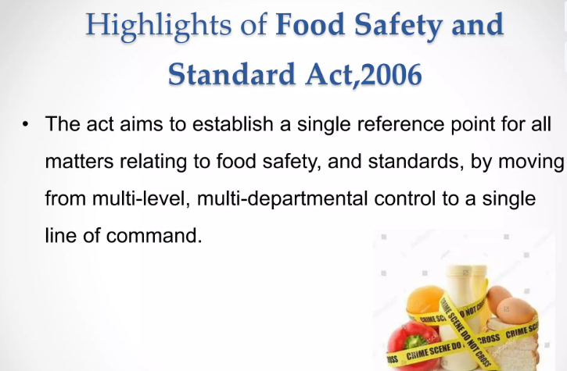

Slide 33
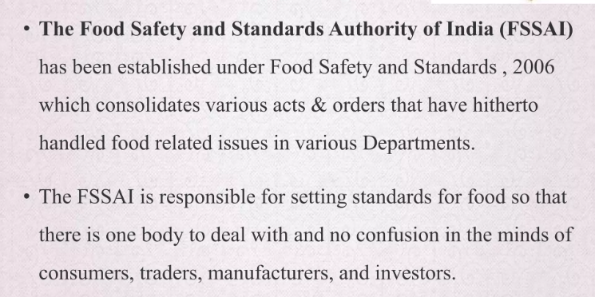

Slide 34
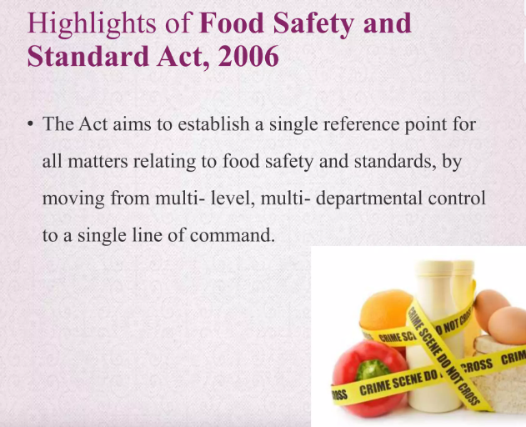

Slide 35
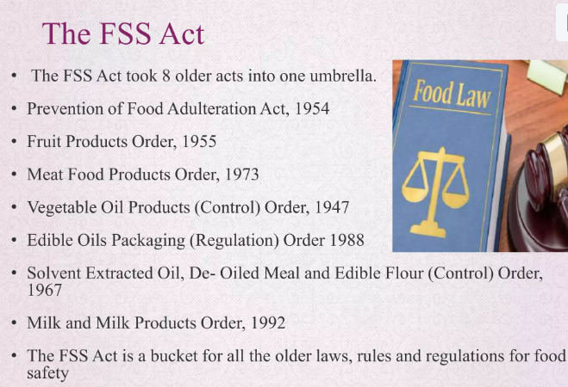

Slide 36
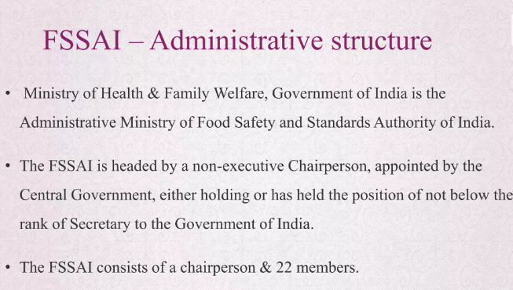
As of October 2024, Shri Sudhansh Pant is the Chairman of the Food Safety and Standards Authority of India (FSSAI). He is also the Secretary of the Ministry of Health and Family Welfare, Government of India

Slide 37
Appointment | The central government appoints the chairperson, who is a non-executive member. The chairperson must have held or currently hold the position of Secretary to the Government of India or higher.
Other members | The FSSAI also has 22 other members, including at least one-third women.
Headquarters | The FSSAI is headquartered in New Delhi.
Regional offices | The FSSAI has regional offices in Delhi, Guwahati, Mumbai, Kolkata, Cochin, and Chennai.
Laboratories | The FSSAI has 22 referral laboratories, 72 state/UT laboratories, and 112 NABL accredited private laboratories.
Enforcement | Food Safety Officers enforce FSSAI provisions.

Slide 38
The FSSAI is a statutory body established under the Food Safety and Standards Act, 2006. It's responsible for protecting and promoting public health through the regulation and supervision of food safety.

Slide 39
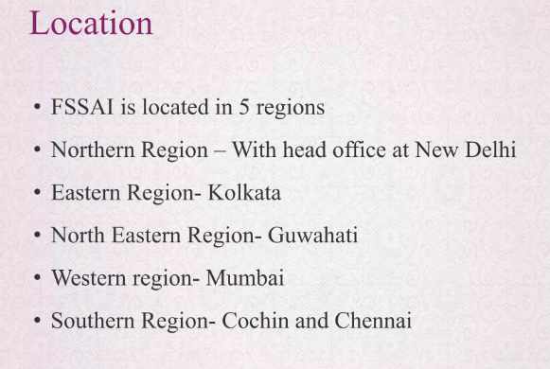

Slide 40
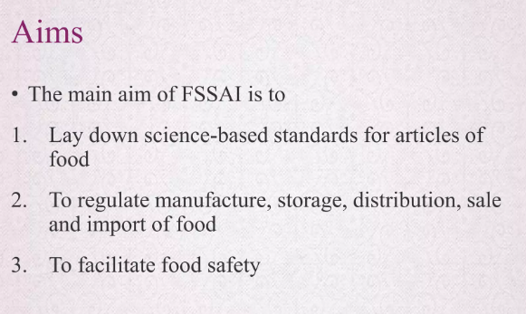

Slide 41
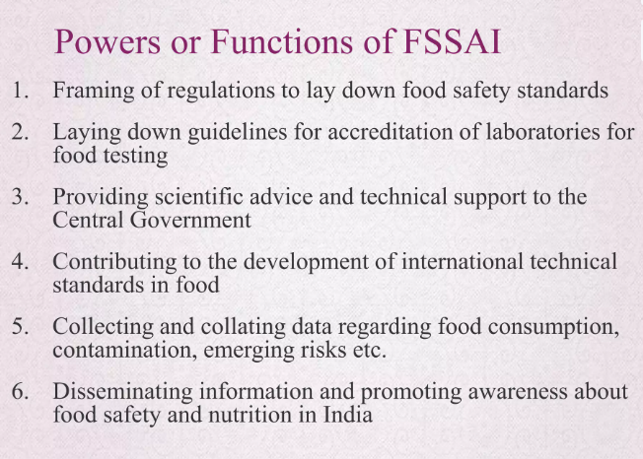

Slide 42
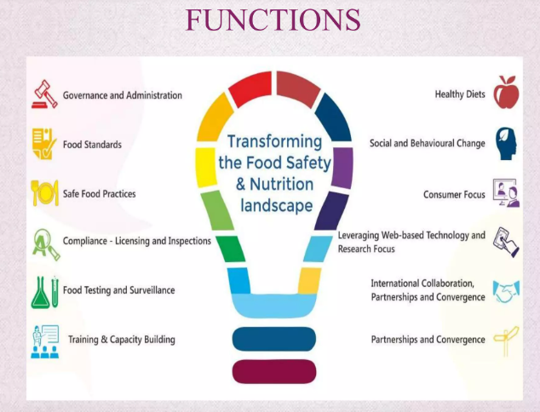

Slide 43
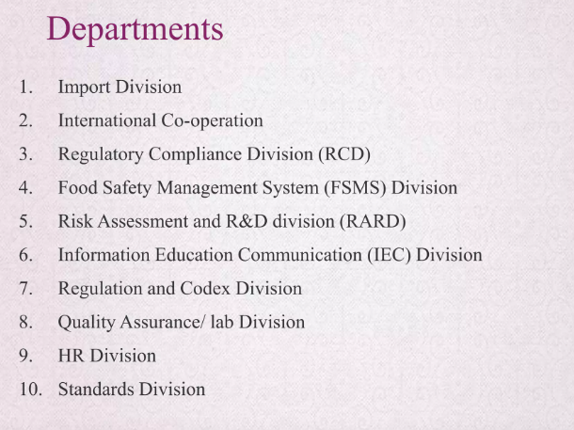

Slide 44
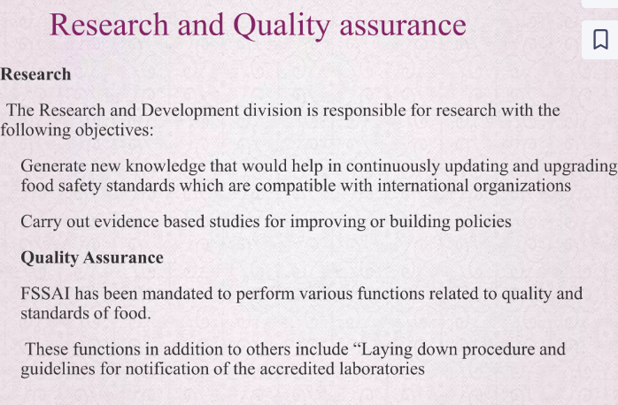

Slide 45
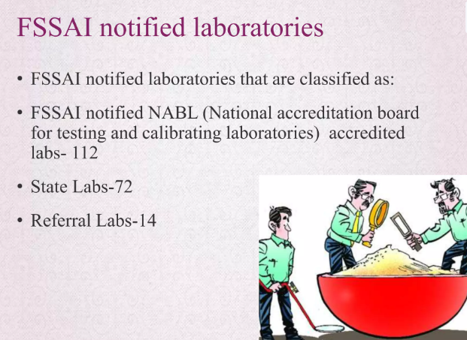

Slide 46
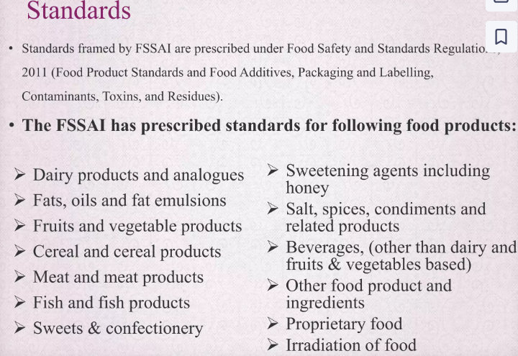

Slide 47
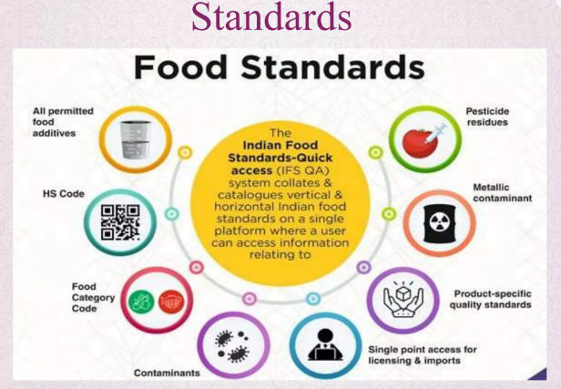

Slide 48
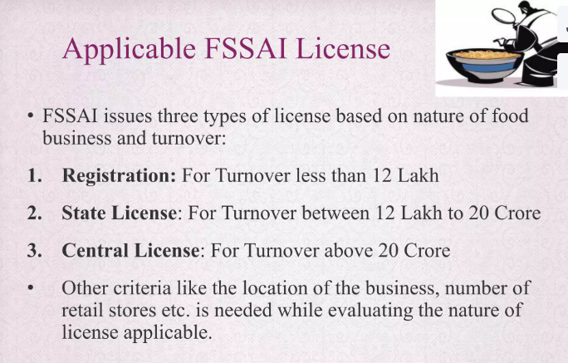

Slide 49
TYPES OF LICENSES
If you want to know How To Get FSSAI License in India, then you must know these three types of licenses.
Generally, FSSAI Registration or License is based on business volume and business establishment. Depending on different factors like Installed capacity, Turnover and Location the Applicants establishments can be eligible for three different Licenses.
Basic License: Basic License is issued by the State Government to the small (manufacturers, storage units, transporters, marketers, and distributors). This License is generally issued to a company with an annual yield of not more than Rs 12,00,000.
Note: This License is issued for a period of a minimum of 1 year and a maximum of 5 years.

Slide 50
State License: This License is generally issued for SMEs like Transporters, Storage Houses, Distributors, and Marketers, etc. The company involved in the food business must have its business operations in one state. The company should have an annual yield of Rs 12, 00,000.
Note: This License is issued by the state government for a minimum of 1 year and a maximum of 5 years.

Slide 51
Central License: This License is generally issued by the Central Government, to the food business operators operating in more than one state or city, companies operating as importers or exporters in food-related business, big manufacturers in the food and processed food-related business, food business operators working with central government agencies, ports, and airports, etc.
Note: If a company involved in food or food-related business (Nutrition Supplement) is operational in different states or cities then it is essential for its head office, to apply for a central License. Along with this Central License is mandatory for a Food Business operator having an annual yield of Rs 20 Crores.

Slide 52
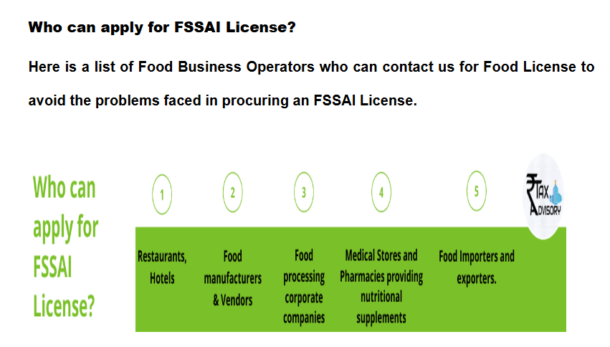

Slide 53
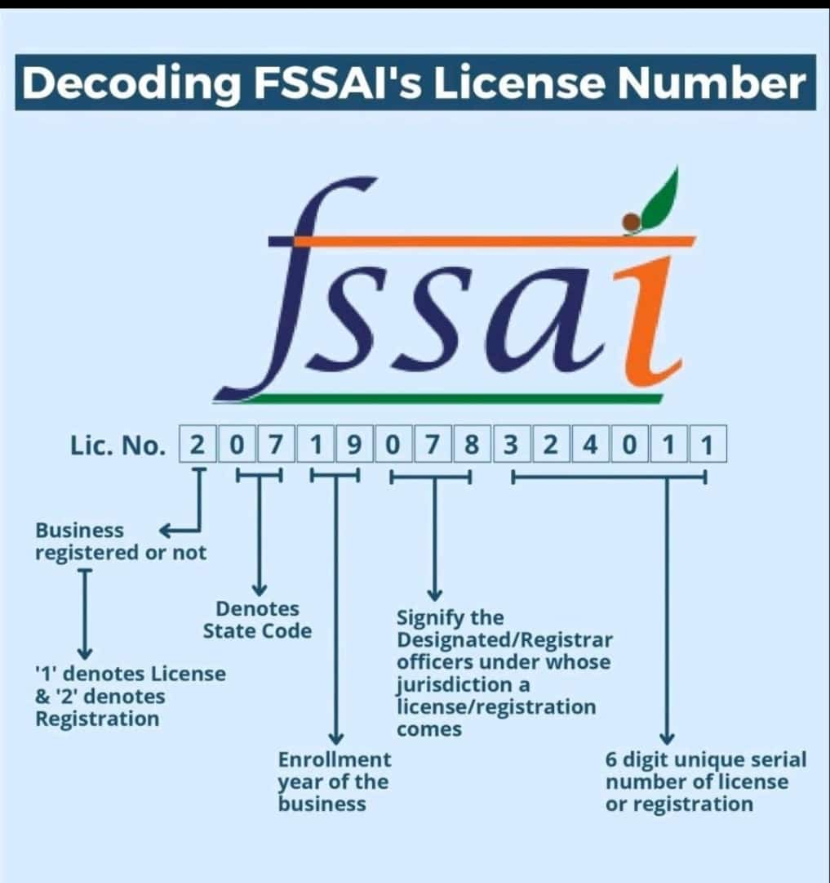
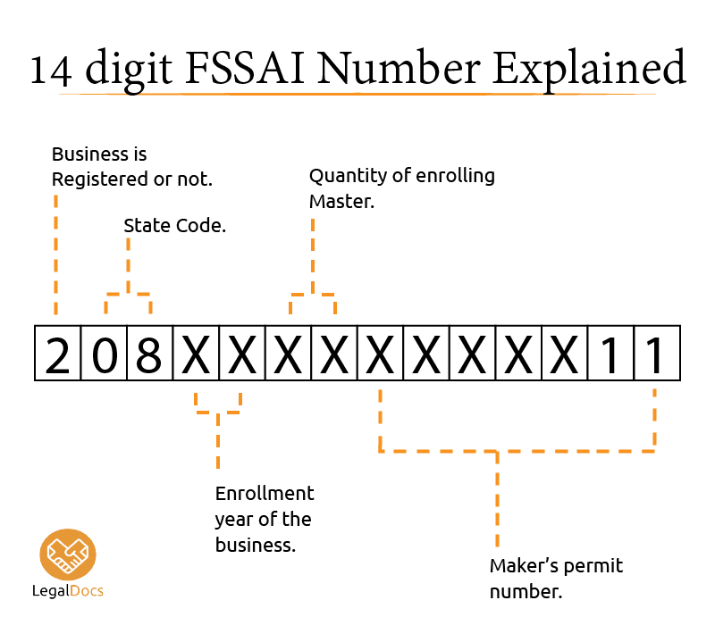

Slide 54
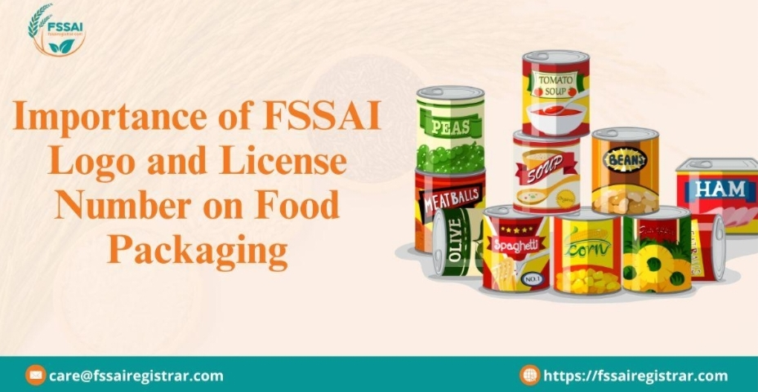
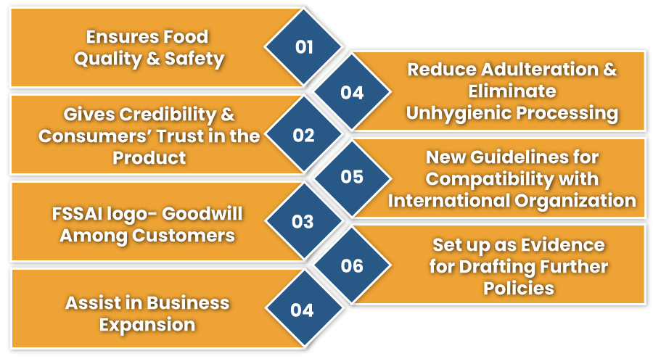

Slide 55
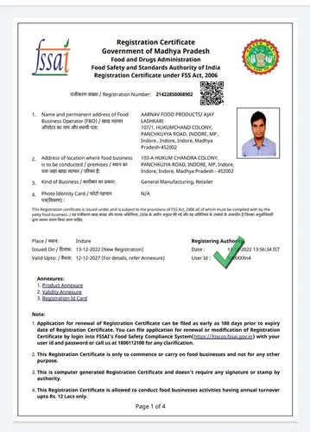
Sample FSSAI license

Slide 56
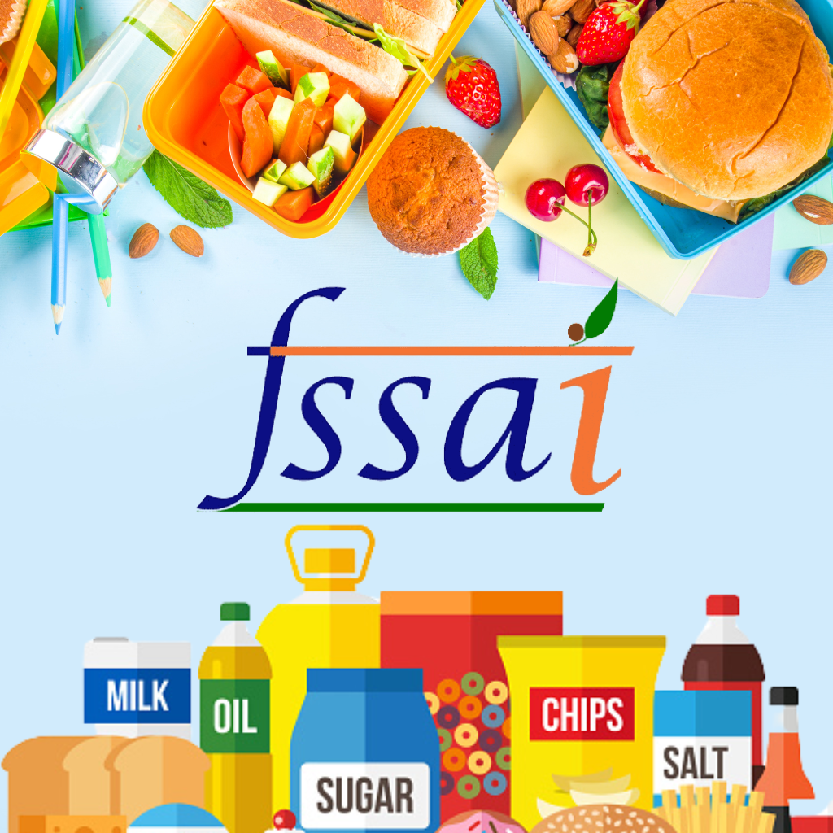
THANK YOU

